Slide 1

Anesthetic Management of Patients with Hypoplastic Left Heart Syndrome for Non-Cardiac Surgery
Rania K. Abbasi, MD, FASA
Associate Professor of Clinical Anesthesia
Riley Hospital for Children
Indianapolis, Indiana, USA

Slide 2
Overview
Anatomy/Pathophysiology/Palliation of hypoplastic left heart syndrome (HLHS)
Preoperative:
  Risk assessment
  Preoperative evaluation
Intraoperative
  Anesthetic goals
  Monitoring
  Anesthetic technique
Postoperative
  Monitoring
  Discharge

Slide 3
HLHS

Slide 4
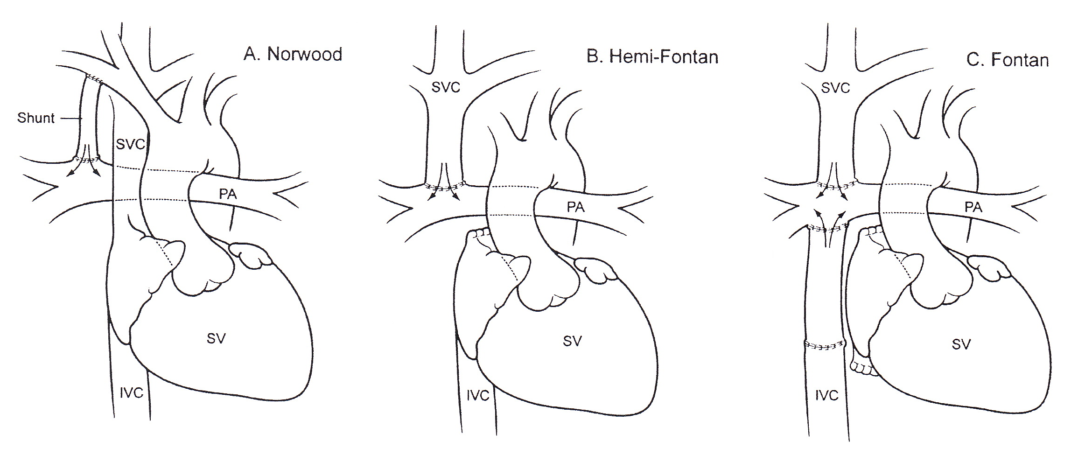
Stages of HLHS Palliation

Slide 5
Risk Assessment

Slide 6
Risk Assessment

Slide 7
Preoperative Evaluation
Understand the anatomy and physiology at each stage of single ventricle palliation
Multi-disciplinary approach
Recent echocardiogram
Hematocrit
NPO status
Medications
IV access
Timing
Anesthetic Bundling

Slide 8
Intraoperative Management
Anesthetic Goals
  Stage I (Norwood)
    Qp:Qs=1:1
    Avoid Low PVR
    Avoid High SVR
    Maintain ventricular function
  Stage II (Hemi-Fontan/Glenn)
    Keep PVR Low
    Optimize intravascular volume
  Stage III (Fontan)
    Keep PVR Low
    Optimize intravascular volume
    Maintain ventricular function

Slide 9
Intraoperative Management
Monitoring
Anesthetic Technique
  Intravenous vs. Inhaled Induction?
  Ventilatory management
  Inotropes

Slide 10
Postoperative Management
Transport is Risky!
Consider ICU postop

Slide 11
Questions?
Rania K. Abbasi, MD, FASA
rabbasi@iu.edu

Slide 12
References:
Gottlieb EA and Andropoulos DB. Anesthesia for the patient with congenital heart disease presenting for noncardiac surgery. Curr Opin Anesthesiol 2013; 26: 318-26.
Twite MD and Ing RJ. Anesthetic considerations in infants with hypoplastic left heart syndrome. Semin Cardiothorac Vasc Anesth 2013; 17(2): 137-45.
Ramamoorthy C, Haberkern CM, Bhananker SM, et al. Anesthesia-related cardiac arrest in children with heart disease: data from the Pediatric Perioperative Cardiac Arrest (POCA) Registry. Anesth Analg 2010; 110: 1376-82.
Brown ML, DiNardo JA, Odegard KC. Patients with single ventricle physiology undergoing noncardiac surgery are at high risk of adverse events. Pediatric Anesthesia 2015; 25: 846-51.
Taylor D and Habre W. Risk associated with anesthesia for noncardiac surgery in children with congenital heart disease. Pediatric Anesthesia 2019; 29: 426-34.
Faraoni D, Vo D, Nasr V, et al. Development and validation of a risk stratification score for children with congenital heart disease undergoing noncardiac surgery. Anesth Analg 2016; 123: 824-30.
Saettele AK, Christensen JL, Chilson KL, et al. Children with heart disease: risk stratification for non-cardiac surgery. Journal of Clinical Anesthesia 2016; 35: 479-484.
Song IK and Shin WJ. Who are at high risk of mortality and morbidity among children with congenital heart disease undergoing noncardiac surgery? Anesth Pain Med 2021; 16: 1-7.
White MC. Approach to managing children with heart disease for noncardiac surgery. Pediatric Anesthesia 2011; 21: 522-29.

